Slide 1

Welcome to Completing the SPCC Template for Qualified Facilities

Slide 2

Expert Training–Anytime, Anywhere™
Lion Technology provides:
  Over 25 California workshops annually
  Title 22 hazardous waste workshops
  Nationwide training: EPA, RCRA, DOT, IATA, IMDG, OSHA
  Convenient online courses
  Tailored on-site training programs

Slide 3

Objectives
Review the triggers for SPCC Plans
Review the definition of “qualified facilities”
Discuss the SPCC Plan Template for qualified facilities
Question-and-answer session

Slide 4

Waters of the State
California defines “Waters of the State” as:
  “any surface water or groundwater, including saline waters, within the boundaries of the state”
The term includes:
  All waters within the State boundaries
  The territorial sea (3 nautical miles from coast)
[CA Water Code, §13050(e)]

Slide 5
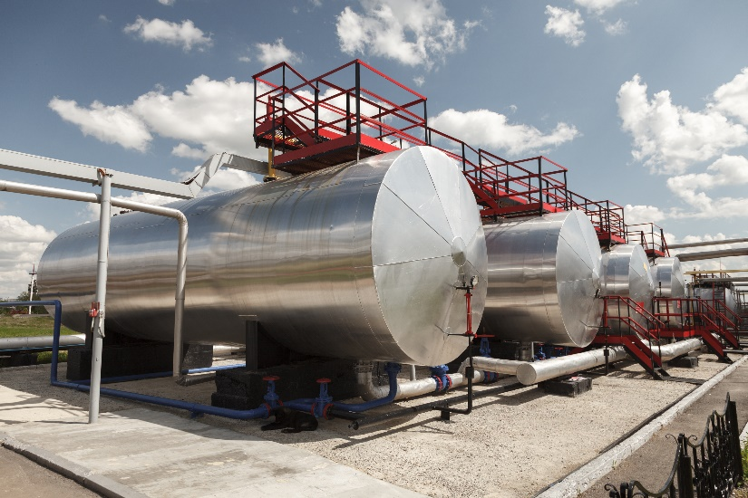
Aboveground Petroleum Storage Act (APSA)
Any tank facility that:
  Is subject to 40 CFR 112; or
  Has a storage capacity of ≥ 1,320 gallons of petroleum must:
    Prepare and implement an SPCC Plan
    Conduct periodic inspections to assure compliance
[Health and Safety Code, Div. 20, Chap 6.67]

Slide 6

APSA Exclusions
Farms, nurseries, logging operations, and construction sites are excluded if:
  No individual storage tank capacity is > 20,000 gallons
  Cumulative storage capacity is not > 100,000 gallons
Underground Storage Tanks (USTs) that are
subject to 40 CFR 280 are also excluded
[Health and Safety Code, §25270.4.5(a)]

Slide 7
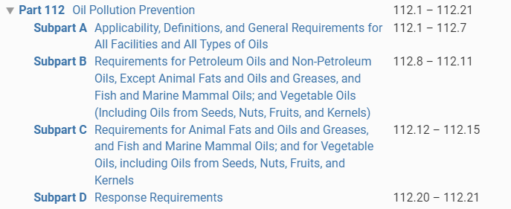
Oil Discharge Prevention
Discharge prevention should be top priority for facilities with on-site oil storage
40 CFR 112 addresses oil pollution prevention
  Certain facilities are required to create and implement a Spill Prevention, Control, and Countermeasure Plan (SPCC Plan)

Slide 8
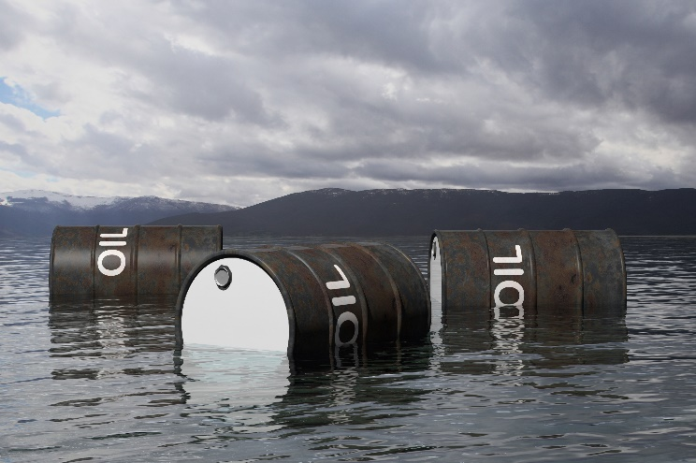
Spill Prevention, Control, and Countermeasure Rule
The purpose of the rule is to ensure certain facilities develop SPCC Plans designed to prevent oil discharges from reaching US navigable waters or adjoining shorelines or, in California, “waters of the state”

Slide 9
APSA vs. Federal SPCC Applicability
CUPAs are only reviewing the SPCC Plan under APSA
APSA only applies to petroleum oils, while SPCC includes all oils (e.g., vegetable oils)
APSA exempts navigable specific facilities (e.g., farms, construction)
APSA reviews sites with a risk to waters of the state in addition to the Federal definition of navigable waters
Federal SPCC Program
Non-Petro oil
and APSA exempt
Petro oil and Nav. Water
Petro
No Nav. Water risk
APSA SPCC Program

Slide 10

Facility Definition
“Facility means any mobile or fixed, onshore or offshore building, property, parcel, lease, structure, installation, equipment, pipe, or pipeline (other than a vessel or a public vessel) used in oil well drilling operations, oil production, oil refining, oil storage, oil gathering, oil processing, oil transfer, oil distribution, and oil waste treatment, or in which oil is used…”
Includes construction and other facilities that have standby, temporary, and seasonal storage
[40 CFR 112.2]

Slide 11
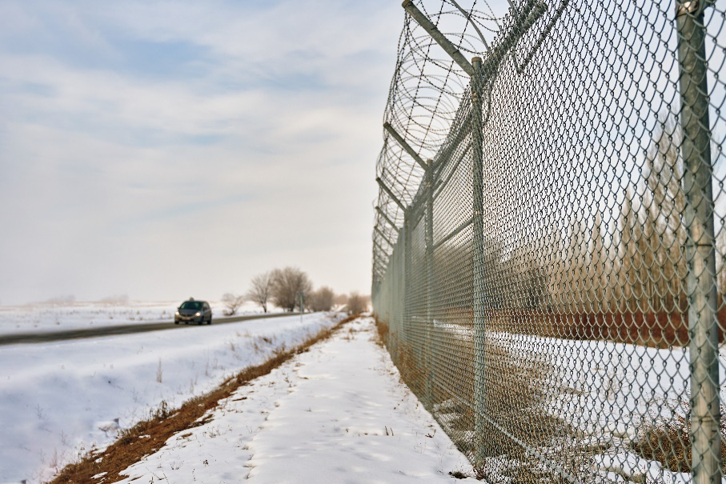
Facility Definition (con’t)
“The boundaries of a facility depend on several site-specific factors, including but not limited to, the ownership or operation of buildings, structures, and equipment on the same site and types of activity at the site. Contiguous or non-contiguous buildings, properties, parcels, leases, structures, installations, pipes, or pipelines under the ownership or operation of the same person may be considered separate facilities.”
[40 CFR 112.2]

Slide 12

Oil Pollution Prevention Program
Non-transportation-related Facilities
The rules apply to owners and operators of facilities involved in:
  On- and offshore activities
  Agriculture
  Non-transportation-related activities
[40 CFR 112.1(b)]

Slide 13
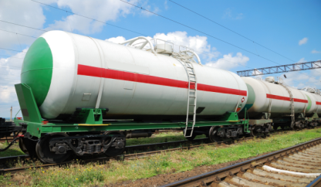
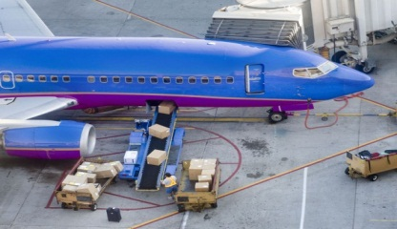
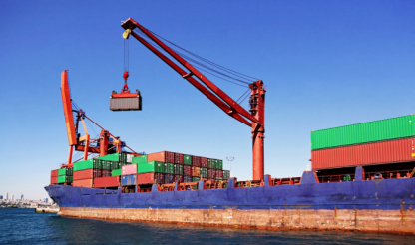
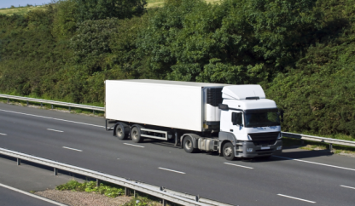
Oil Pollution Prevention Program
Transportation-related Facilities
The rules do not apply to transportation-related facilities
  Rail
  Aircraft
  Vessel
  Highway
They may or may not apply to pipelines and gathering lines
Transportation facilities are regulated by the Department of Transportation (DOT)
[40 CFR 112.1(d)]

Slide 14

Non-transportation-related Activities
Non-transportation-related activities include:
  Oil production (drilling, gathering, refining, processing, and workover)
  Transferring
  Distributing
  Storing
  Using
  Consuming
[40 CFR 112.1(b)]

Slide 15
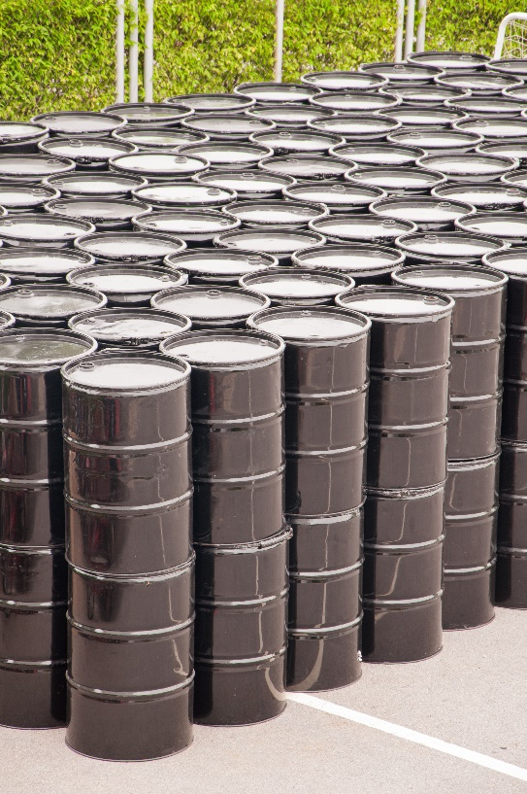
Capacity Triggers
You must have an SPCC Plan if your facility has:
  More than 1,320 gallons of oil in aggregate above-ground storage capacity
  More than 42,000 gallons of completely buried oil storage capacity
  A “reasonable expectation of an oil discharge” to a waterway or adjoining shoreline
[40 CFR 112.1]

Slide 16
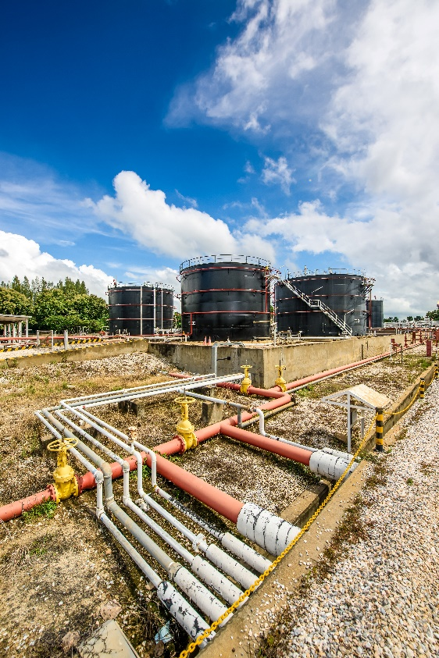
Capacity Criteria
Counted:
Containers with a capacity of 55 gallons
or greater, including:
  Tanks and tank batteries
  Mobile or portable containers
  Oil-filled equipment
  Flow-through process equipment
  Operational equipment

Slide 17
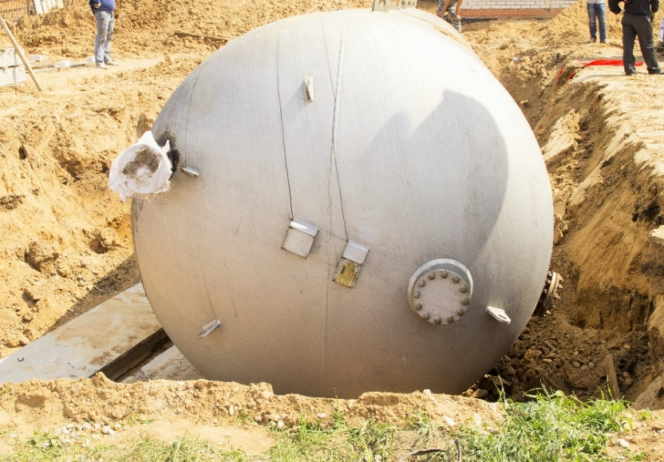
Capacity Criteria
Exclusions
NOT counted:
  Containers with less than 55-gallon capacity (e.g., 30-gallon drum, quart-sized container)
  Permanently closed containers/facilities
  Underground storage tanks subject to 40 CFR 280

Slide 18
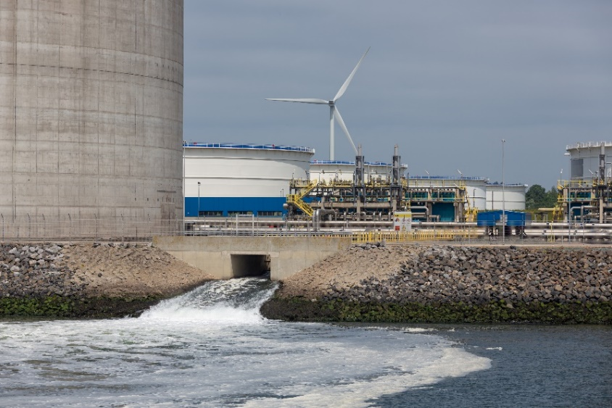
Oil Pollution Prevention Program
Applicability
Applies to facilities located in close proximity to nearby surface waters
  It’s reasonable to expect that the facility could discharge oil in harmful quantities into or upon a navigable water of the US or adjoining shoreline
Note: The APSA program also includes “Waters of the State”
[40 CFR 112.1]

Slide 19

Oil Pollution Prevention Program
Applicability Determination
The owner/operator decides if the facility meets the applicability criteria
  Based on quantity and nature of oil stored, geography, and location
  Consider topography, drainage, and distance to water
  Exclude discharge prevention features (e.g., secondary containment, response capability)

Slide 20
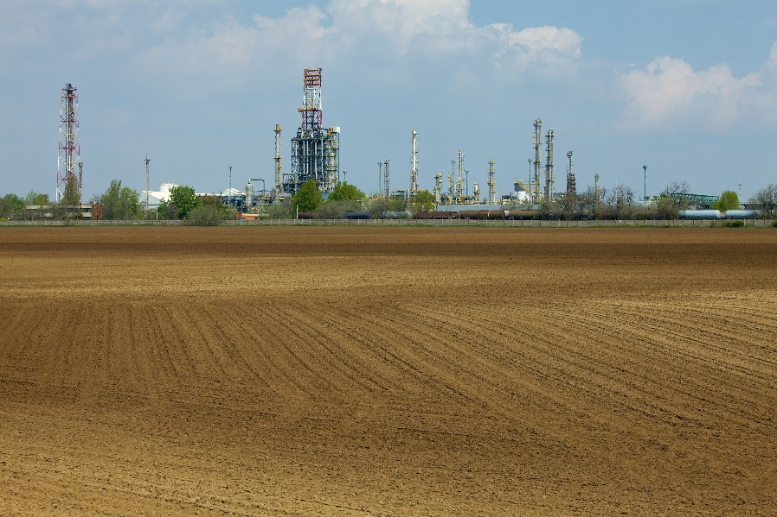
SPCC Plan
Location Exclusion
Facilities residing in locations where it is not reasonable to expect that an oil discharge could reach navigable waters are excluded from the Plan requirements
[40 CFR 112.1(d)]

Slide 21

SPCC Plan
Location Exclusion
Exclusion is based on natural geographic and topographic consideration only
  Secondary containment and man-made obstructions do not count
It’s unlikely that many facilities can use this exclusion since a surface water is typically nearby
[40 CFR 112.1(d)]

Slide 22

SPCC Plan
Capacity Exclusion
Facilities with a limited storage capacity for oil may not be required to develop an SPCC Plan
  Based on both aboveground and underground storage limits
  Must account for each on-site storage location reasonably expected to store some type of oil
[40 CFR 112.1(d)]

Slide 23
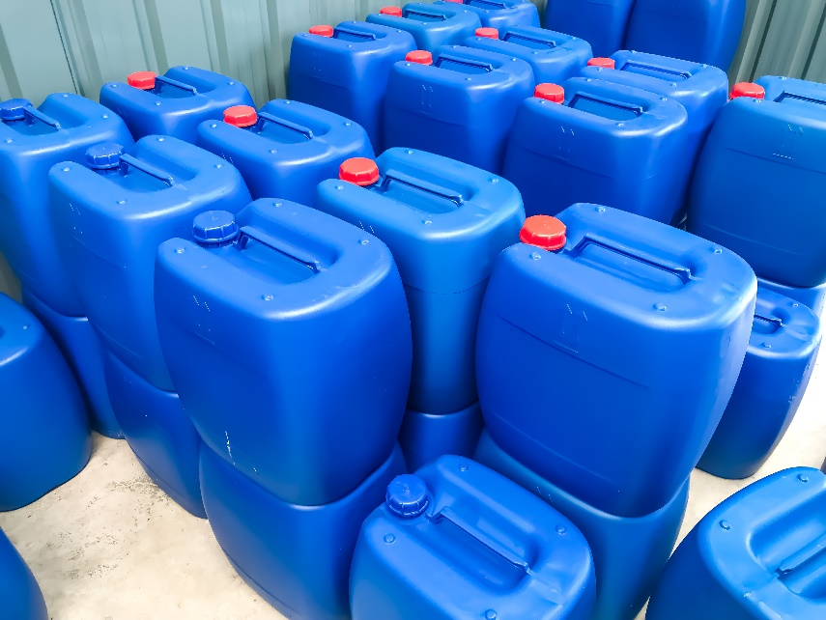
SPCC Plan
Capacity Exclusion – Aboveground Limits
Facilities are not required to have a Plan if their total aboveground storage capacity is ≤ 1,320 gallons
  Don’t have to include containers that are less than 55 gallons
[40 CFR 112.1(d)]

Slide 24

SPCC Plan
Capacity Exclusion – Underground Storage Tanks
“Completely buried tank means any container completely below grade and covered with earth, sand, gravel, asphalt, or other material”
  Includes connected underground piping, underground ancillary equipment, and containment systems
  Excluded from capacity calculation for SPCC, but must be indicated on the facility diagram
Containers in vaults, bunkered tanks, or partially buried tanks are considered aboveground storage containers
[40 CFR 112.1(d) and 112.2]

Slide 25
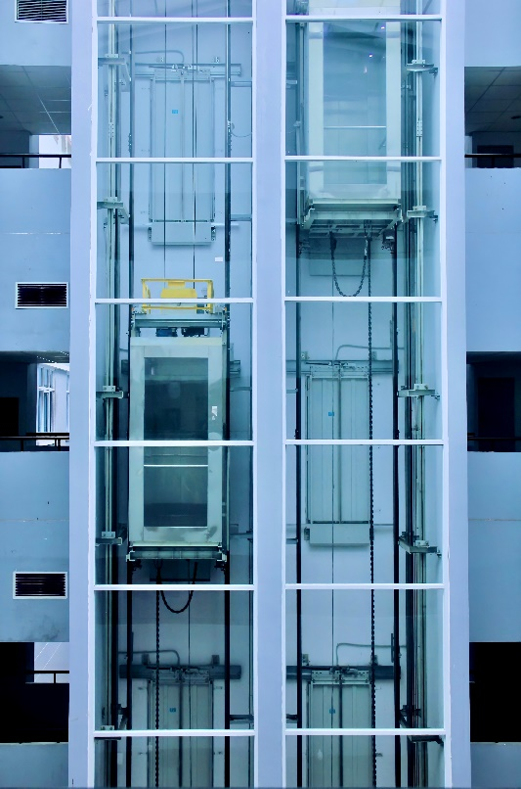
APSA
Tanks In Underground Areas (TIUGAs)
Facilities with storage capacity <1,320 gallons which have 1 or more TIUGAs are subject to the requirements unless the TIUGA(s):
  Holds hydraulic fluid for a closed loop system for elevators/lifts/similar devices;
  Is a heating oil tank; or
  Is a sump, separator, clarifier, catch basin, or storm drain
[HSC §25270.3]

Slide 26
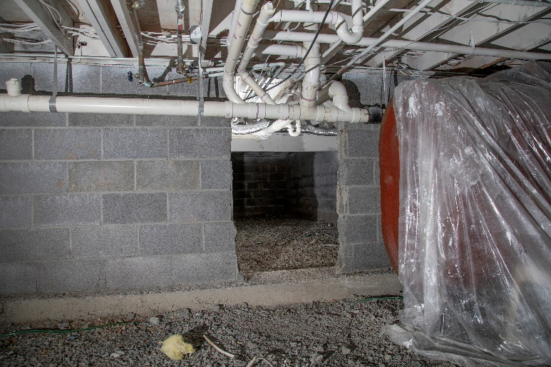
APSA
Tanks In Underground Areas (TIUGAs)
TIUGAs meet certain criteria and are located in a structure that is:
  At least 10 percent below the ground surface (basement, cellar, shaft, pit, vault, etc.)
    “Below grade but not buried”
  Able to provide for secondary containment of the contents of the tank, piping, and ancillary equipment until cleanup occurs
  Sufficient to allow for direct viewing of the exterior of the tank, except for that part in contact with the surface of the floor
[HSC §25270.2(o)]

Slide 27
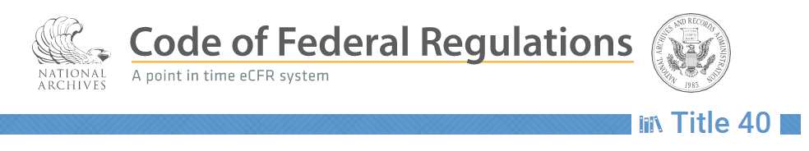
SPCC Plan
Capacity Exclusion – Underground Limits
Facilities must meet both aboveground and underground storage capacity limits to qualify for the exclusion
Underground storage capacity limit is 42,000 gallons
Not required to include underground storage tanks (USTs) managed under RCRA Federal regulations and State-approved programs [40 CFR 280 through 282]
[40 CFR 112.1(d)]

Slide 28

SPCC Plan Certification
Many Plans must be reviewed and certified by a licensed Professional Engineer (PE)
  Engineer must be familiar with Federal and State regulations that apply to oil pollution prevention
  Engineer’s certification affirms that PE has visited and inspected the facility
[40 CFR 112.3(d)]

Slide 29
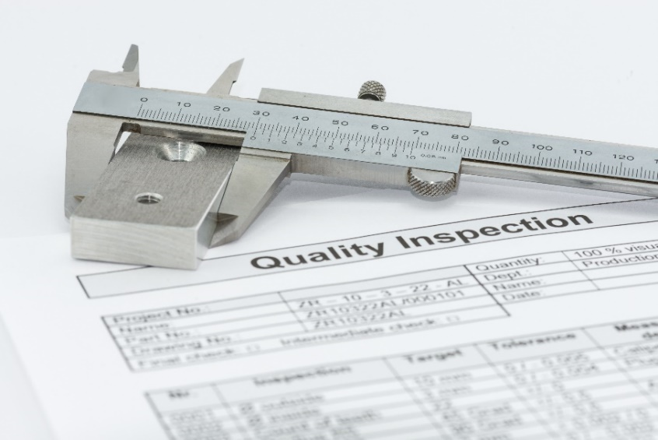
SPCC Plan Certification
Professional Engineer (PE) Certification
PE must attest that the Plan:
  Is adequate for the facility
  Was written in compliance with the SPCC rules, following good practices and industry standards
  Establishes inspection and testing protocols
[40 CFR 112.3(d)]

Slide 30

SPCC Plan Certification
All technical amendments made to the Plan require certification by a licensed PE
  Exceptions do apply to “qualified facilities”
Periodic reviews of the SPCC Plan do not require PE certification
[40 CFR 112.5 and 112.6]

Slide 31
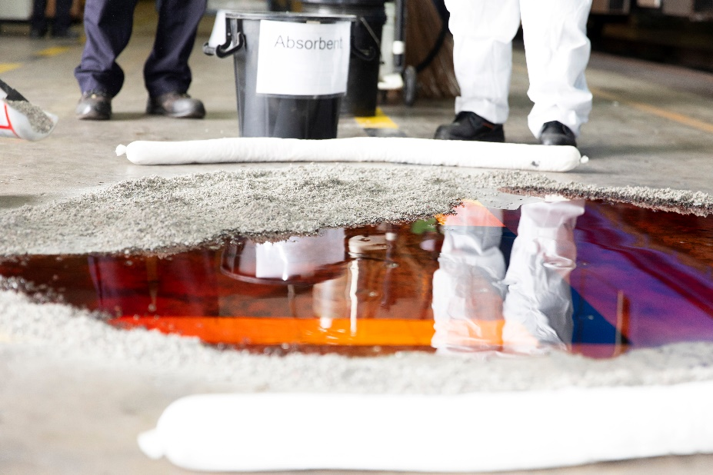
SPCC Plan Self-Certification
Definition of Qualified Facilities
Qualified facilities are permitted to self-certify their SPCC Plans (no licensed PE required), provided they have:
  Total aboveground oil storage capacity of
  ≤ 10,000 gallons
  Minimal spill history within the three years leading up to the Plan’s self-certification date
[40 CFR 112.3(g)]

Slide 32
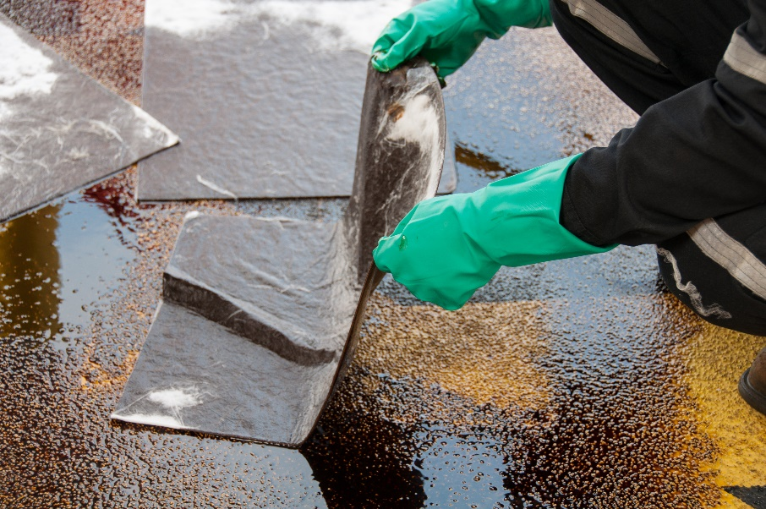
SPCC Plan Self-Certification
Definition of Minimal Spill History
A “minimal spill history” is defined as either:
  No single discharge > 1,000 gallons within any 12-month period during the three years leading up to the Plan’s self-certification date; or
  No two discharges > 42 gallons each within any 12-month period during the three years prior to the Plan’s self-certification date
[40 CFR 112.3(g)]

Slide 33

SPCC Plan Self-Certification
Types of Qualified Facilities
There are two types of qualified facilities:
  Tier I
  Tier II

Slide 34

Tier I Qualified Facilities
Total aboveground container storage capacity must be
≤ 10,000 gallons;
In the three years prior to the Plan certification:
  No spills to navigable waters of the US and adjoining shorelines greater than 1,000 gallons, or
  No two spills greater than 42 gallons in a 12-month period; and
No individual aboveground container can exceed 5,000-gallon capacity
[40 CFR 112.3(g)]

Slide 35
Tier II Qualified Facilities
Total storage capacity of aboveground containers must be
≤ 10,000 gallons
In the three years prior to the Plan certification:
  No spills to navigable waters of the US and adjoining shorelines greater than 1,000 gallons or
  No two spills greater than 42 gallons in a 12-month period; and
Individual aboveground containers may exceed 5,000-gallon storage capacity
[40 CFR 112.3(g)]

Slide 36
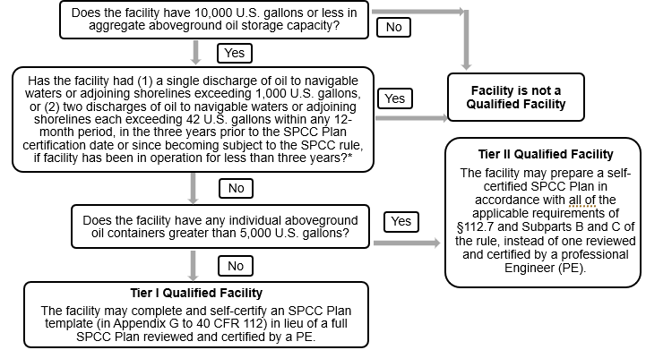
Tier I and II Qualified Facility Eligibility Requirements and Options

Slide 37
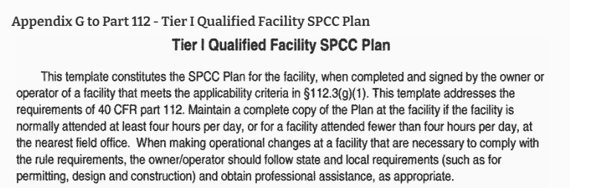
SPCC Plan Self-Certification
Tier I Facility Advantage
Tier I qualified facilities may complete a streamlined SPCC Plan template document, rather than create a Plan from scratch
  May complete an abbreviated version of the Plan
  Plan template is found in Appendix G to 40 CFR 112
  EPA’s website includes links to downloadable/editable documents and examples of completed SPCCs
[40 CFR 112.6]

Slide 38

SPCC Plan Self-Certification
Tier I and II Facilities
Tier I and II qualified facilities may use the Plan template and must prepare a standard written Plan according to:
  Rules found in 40 CFR 112.7
  Applicable requirements found in 40 CFR 112, Subparts B and C
  Cal OSFM has created a template that meets Tier II facility requirements
Like Tier I facilities, Tier II facilities may also self-certify their Plans

Slide 39

SPCC Plan Certification
Self-Certification
The owner/operator of a qualified facility must certify that the SPCC Plan:
  Has been prepared per the regulations and follows best industry practices and standards
  Is approved by management and commits the resources to execute it
  Will be implemented

Slide 40
SPCC Plan Certification
Self-Certification
The owner/operator of a qualified facility must certify that the SPCC Plan:
  Includes discharge notification information
  Will be reviewed and amended at least once every five years

Slide 41
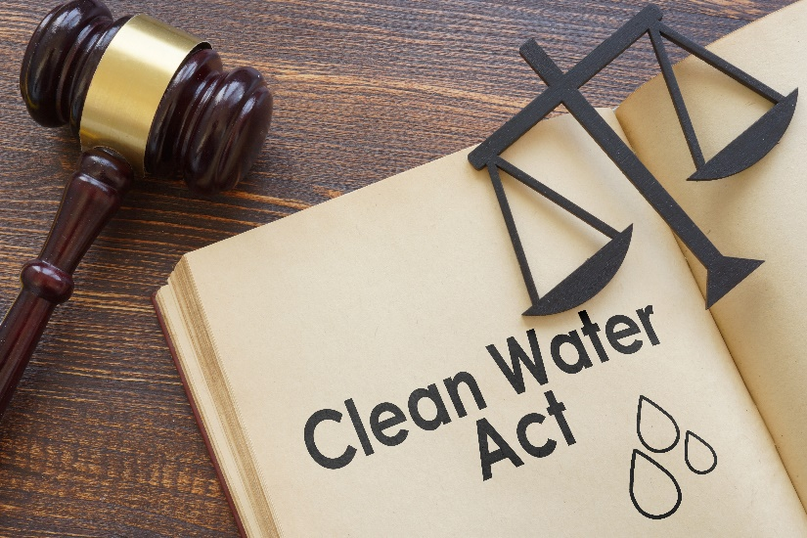
Discharges of Oil
The Clean Water Act (CWA) prohibits discharges of oil into or upon navigable waters of the US in amounts that could cause harm to human health or the environment
  Navigable waters include large water bodies as well as tributaries, lakes,
  ponds, etc.
The CWA requires reporting of oil discharges to navigable waters by the responsible person

Slide 42
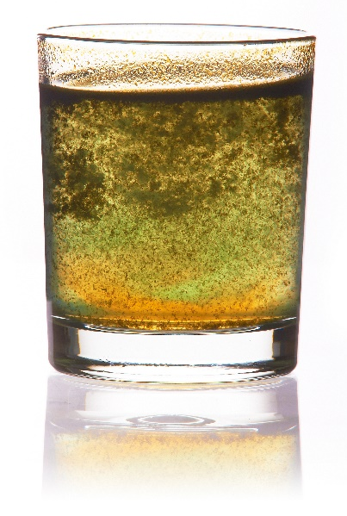

Oil Discharges That “May Be Harmful”
The rules implementing the oil discharge portion of the Clean Water Act are found at 40 CFR 110
  The EPA describes discharges of oil in quantities that “may be harmful” as those that:
    Violate water quality standards established by the State or Federal EPA
[40 CFR 110.3]

Slide 43
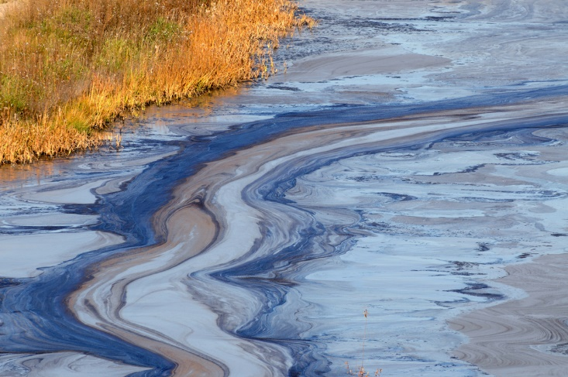
Oil Discharges That “May Be Harmful”
The EPA describes discharges of oil in quantities that “may be harmful” as those that:
  Cause a film or sheen on the surface of the water or discoloration; or
  Cause a sludge or emulsion to be deposited beneath the surface of the water or on the shorelines
[40 CFR 110.3]

Slide 44


Oil Discharge Notification
If a discharge occurs, immediately notify the National Response Center (NRC)
Options for providing notification include:
  Call the NRC at 1-800-424-8802 or 1-202-426-2675 (Washington, DC area only)
  Call one of the Coast Guard district offices
  Contact the nearest EPA regional office
[40 CFR 110.6]

Slide 45
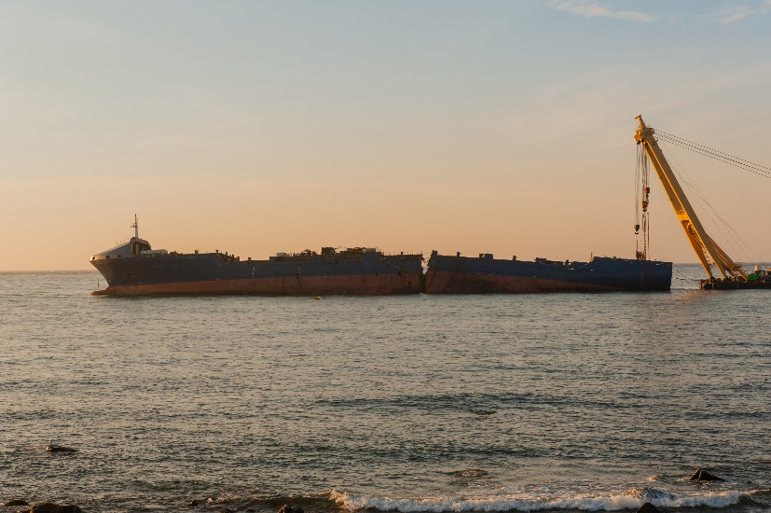
Reporting Oil Spills
People in charge of vessels or facilities must notify the NRC immediately upon knowledge of the discharge
  NRC relays information to the EPA or US Coast Guard, depending on the location of the incident
On-scene coordinators evaluate the situation and decide if emergency response is required
[40 CFR 110.6]

Slide 46
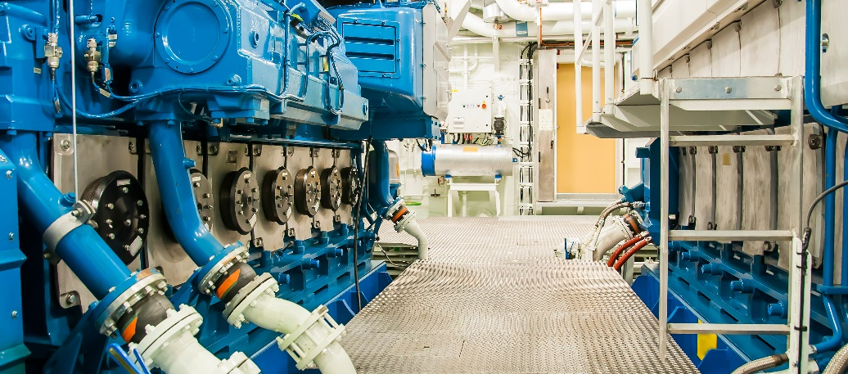
Oil Discharge Notification Exclusions
Discharges of oil that are not determined to be harmful are excluded from the normal notification requirements and include discharges:
  From properly functioning vessel engines
  Allowed under MARPOL 73/78, Annex I
  Permitted for research, demonstrations, or studies
[40 CFR 110.5]

Slide 47


SPCC Reporting Requirements
Facilities subject to the SPCC Rule must report certain discharges to the EPA Regional Administrator within 60 days
Report oil discharge(s) to navigable waters or adjoining shorelines of:
  More than 1,000 gallons (single event)
  More than 42 gallons (in each of two events within a
  12-month period)
Also, send the report to the agency of the state in which the facility is located
[40 CFR 112.4]

Slide 48

Oil Discharge Notification
Any discharge or threatened discharge of oil into “State Waters” must be reported to Cal OES
Discharges under 42 gallons that do not threaten to cause harm to the public health and safety, the environment, or property do not need to be reported.

Slide 49
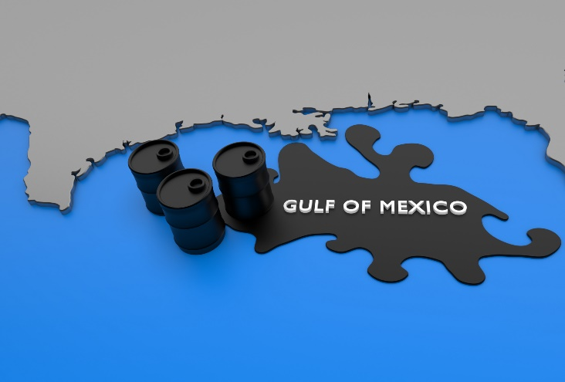
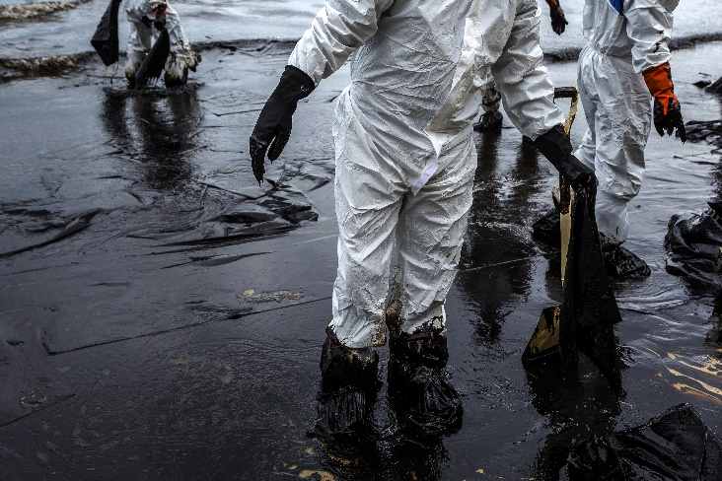
SPCC Oil Discharge Report Elements
When reporting oil discharges, include:
  Names, location, and phone numbers
  Maximum capacity and normal throughput
  Discharge cause and failure analysis
  Preventive measures
  Other information as required
[40 CFR 112.4(a)]

Slide 50
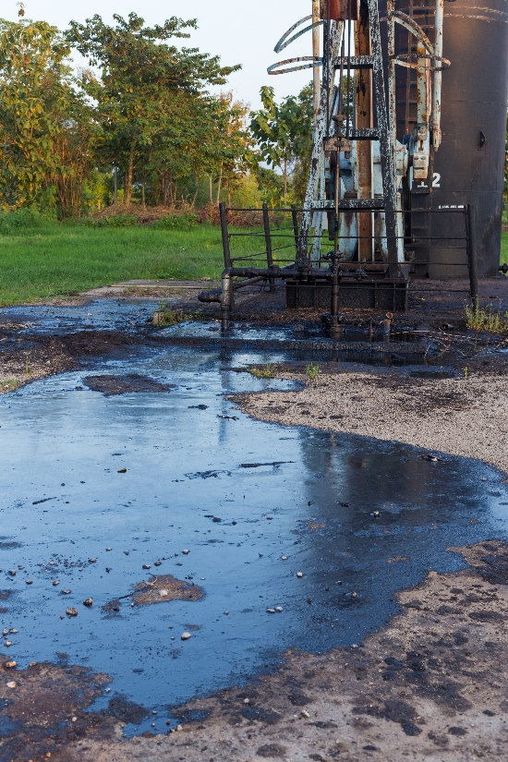
SPCC Oil Discharge Report Elements
Facility Details
Provide an adequate facility description, including:
  Specific discharge location
  Facility layout map(s)
  Flow diagrams
  Topographical maps
[40 CFR 112.4(a)]

Slide 51

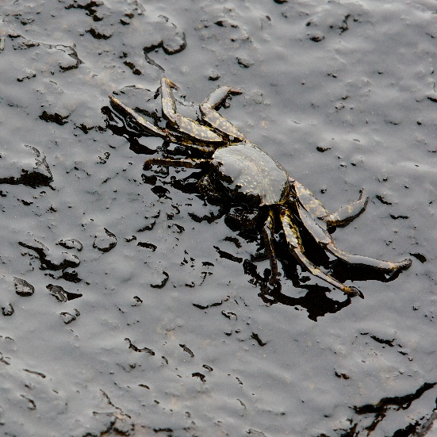
SPCC Oil Discharge Report Elements
Discharge Details
Include discharge details on the report, such as:
  Date and time
  Type of material
  Total or estimated quantity
  Discharge effects (e.g., damages, injuries)
[40 CFR 112.4(a)]

Slide 52
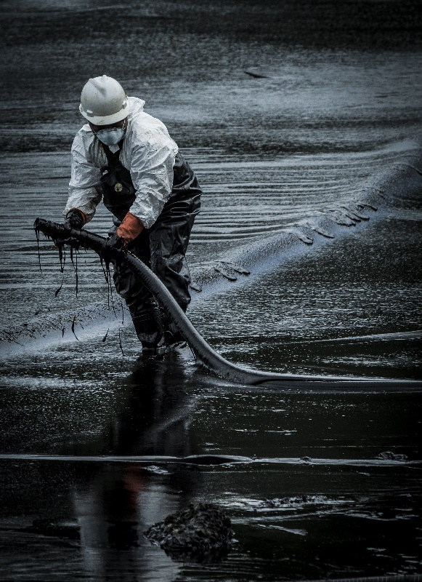
SPCC Oil Discharge Report Elements
Countermeasures and Corrective Actions
Report any actions that were taken, including:
  Countermeasures
    Response activities to stop, remove, and/or lessen the effects of the discharge (e.g., evacuation, containment)
    Contacting additional resources for assistance
  Corrective measures (e.g., maintenance, repair, replacement)
[40 CFR 112.4(a)]

Slide 53
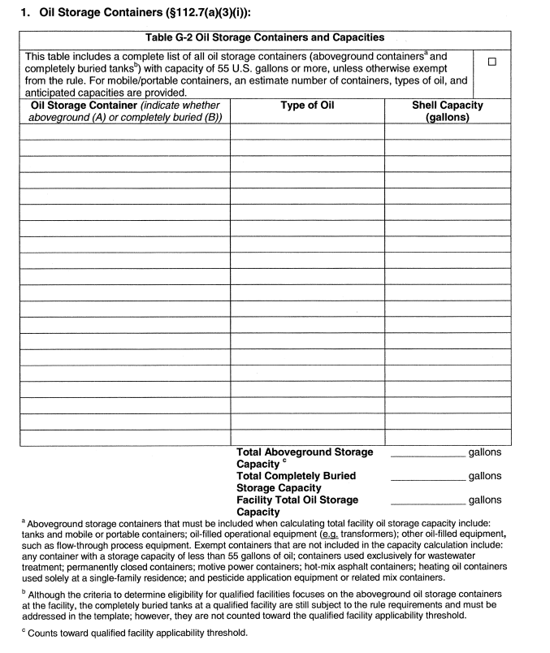
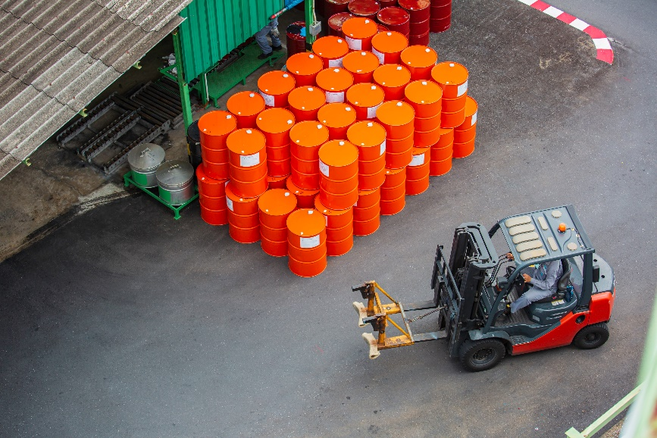
SPCC Plan Components
Table G-2
Table G-2 is for listing oil storage containers and capacities

Slide 54
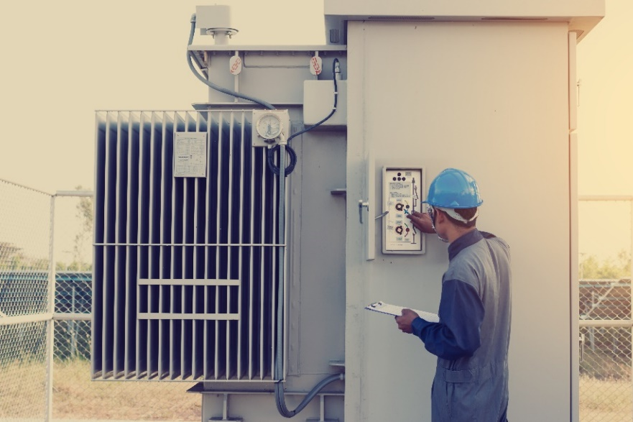
SPCC Plan Components
Table G-2
Aboveground containers include:
  Tanks and mobile or portable containers
  Oil-filled operational equipment (e.g., transformers)
  Other oil-filled equipment (reservoir capacity)

Slide 55
SPCC Plan Components
Table G-2
For mobile/portable containers, estimate:
  Number of containers
  Types of oil
  Anticipated capacities

Slide 56
SPCC Plan Components
Table G-2
Completely buried tanks are not counted towards the qualified facility applicability threshold, but must be addressed in the template

Slide 57

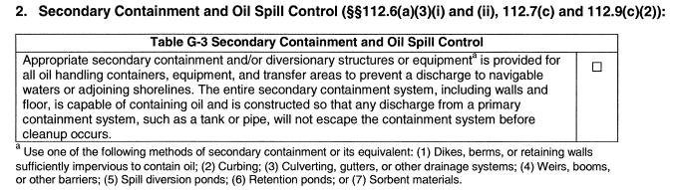
SPCC Plan Components
Table G-3
Table G-3 is for certification of secondary containment/diversionary structures:
  Capable of containing oil
  Constructed so that any discharge from a primary containment system will not escape secondary containment before cleanup occurs

Slide 58
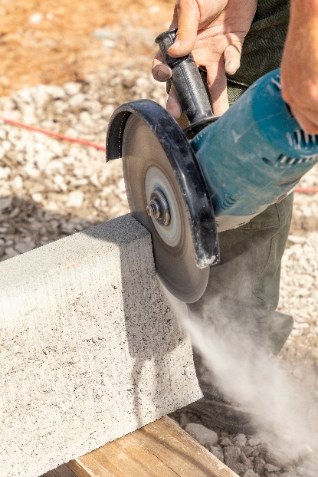
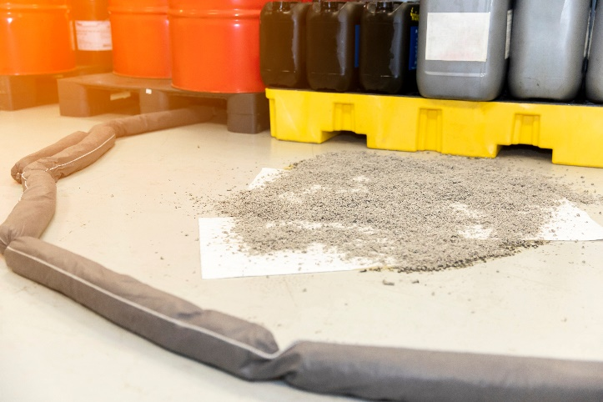
SPCC Plan Components
Table G-3
Secondary containment/diversionary structures include:
  Sufficiently impervious dikes, berms, retaining walls
  Curbing
  Culverting, gutters, other drainage systems
  Weirs, booms, other barriers
  Spill diversion ponds
  Retention ponds
  Sorbent materials

Slide 59
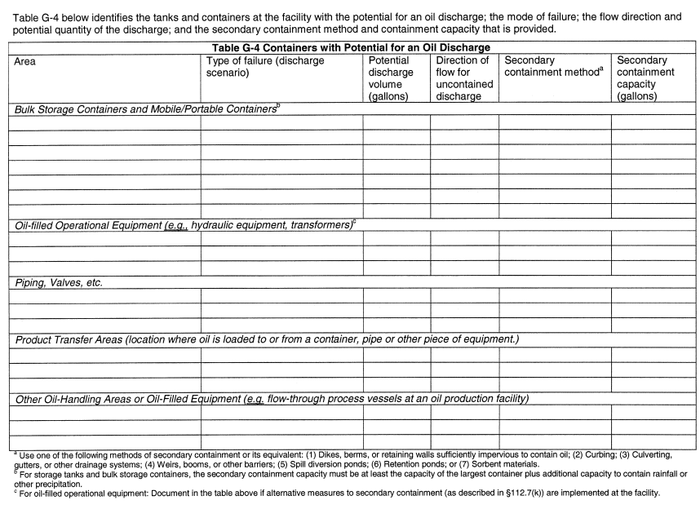
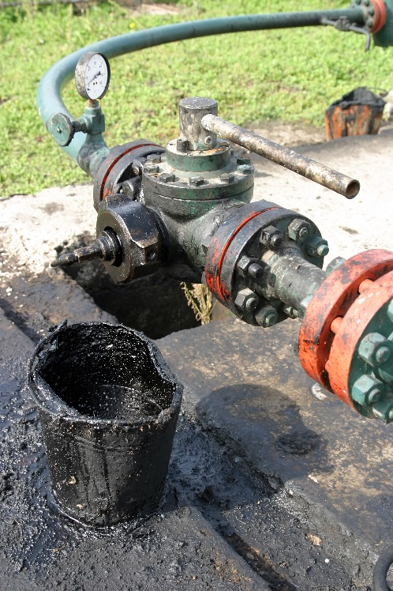
SPCC Plan Components
Table G-4
Table G-4 is for identifying tanks and containers with the potential for an oil discharge

Slide 60
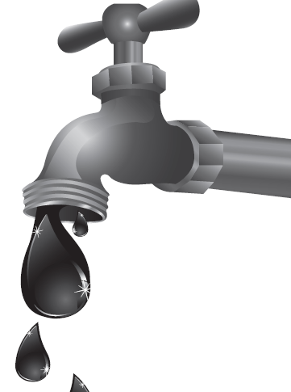
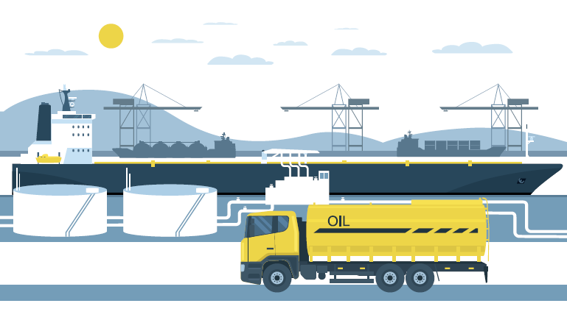
SPCC Plan Components
Table G-4
There are different sections for:
  Bulk storage containers and mobile/portable containers
  Oil-filled operational equipment
  Piping/valves, etc.
  Product transfer areas (loading/unloading, filling/emptying)
  Other oil-handling areas

Slide 61
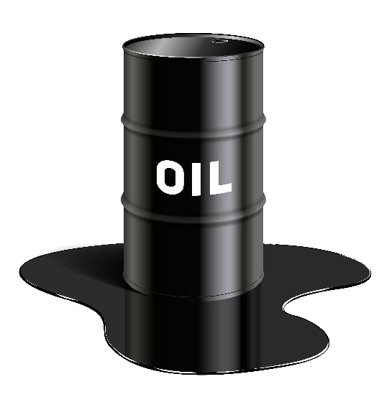
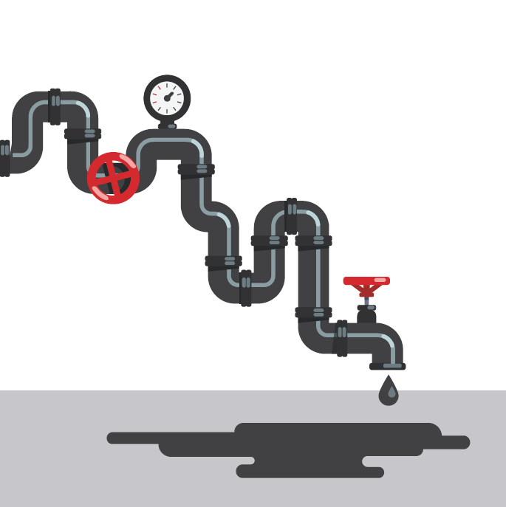
SPCC Plan Components
Table G-4
Include the following information:
  Description of the area
  Discharge scenario
  Potential discharge volume (gallons)
  Direction of flow for uncontained discharge
  Secondary containment methods
  Secondary containment capacity (gallons)

Slide 62
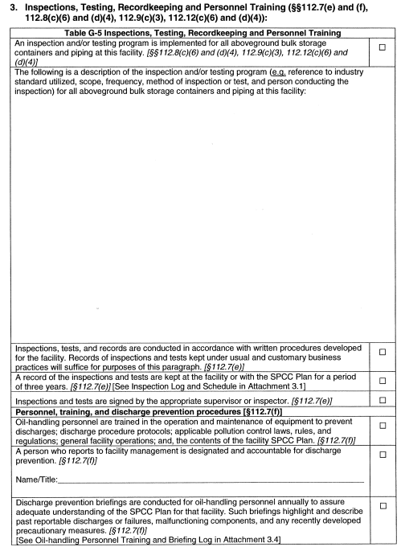

SPCC Plan Components
Table G-5
Table G-5 is for describing inspection/
testing programs, personnel training, and recordkeeping

Slide 63

SPCC Plan Components
Table G-5
Must develop an inspection/testing program for all aboveground bulk storage containers and piping, which includes:
  Reference to industry standard utilized
  Scope and frequency of inspection/testing
  Name of person conducting inspection/testing

Slide 64

SPCC Plan Components
Table G-5
Records of inspections/testing must be:
  Kept under usual and customary business practices
  Retained for a period of three years
  Signed by appropriate supervisor or inspector

Slide 65
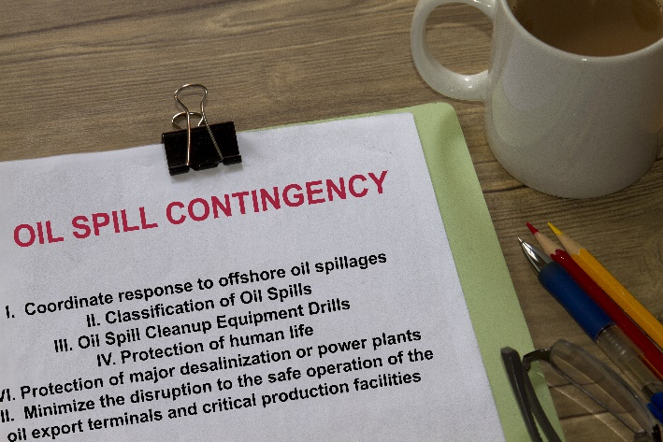
SPCC Plan Components
Table G-5
Personnel must be trained in:
  Operation and maintenance of equipment to prevent discharges
  Discharge procedure protocols
  Applicable pollution control laws, rules, and regulations
  General facility operations
  Contents of the SPCC Plan

Slide 66

SPCC Plan Components
Table G-5
Discharge prevention briefings must occur annually
  Highlight and describe:
    Past reportable discharges or failures
    Malfunctioning components
    Recently developed precautionary measures
  Assure adequate understanding of the SPCC Plan

Slide 67

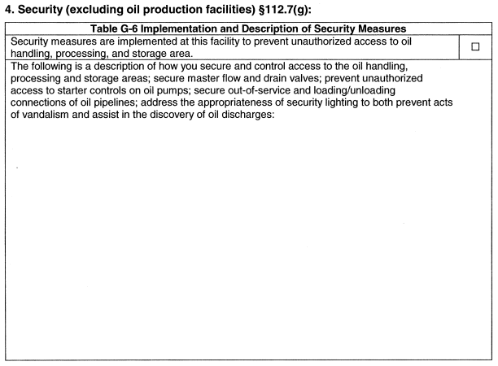
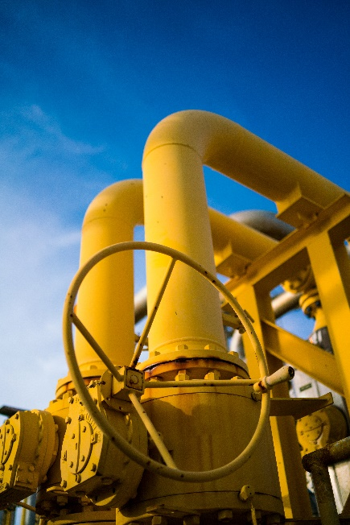
SPCC Plan Components
Table G-6
Table G-6 is for describing security measures

Slide 68
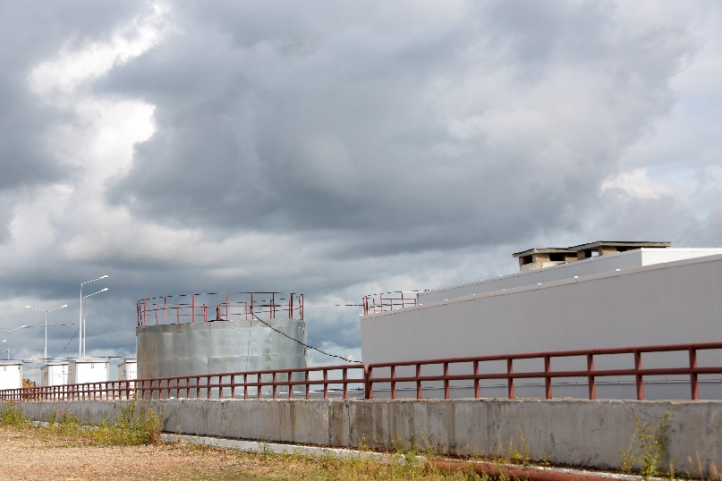
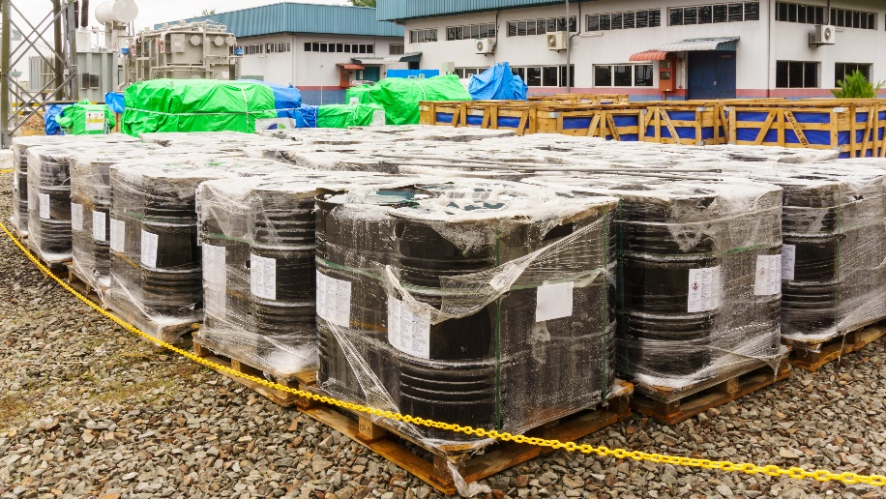
SPCC Plan Components
Table G-6
Describe how you secure and control access to:
  Oil handling, processing, and storage areas
  Master flow and drain valves
  Starter controls on oil pumps
  Out-of-service and loading/unloading areas

Slide 69


SPCC Plan Components
Table G-7
Table G-7 is for describing emergency procedures and release notification procedures
Notification procedures should include the additional requirement from spills of less than 42 gallons into State Waters to Cal OES

Slide 70



SPCC Plan Components
Table G-8
Table G-8 is for the contact list

Slide 71


SPCC Plan Components
Table G-8
Include telephone numbers for:
  National Response Center (1-800-424-8802)
  Clean-up contractors
  Key facility personnel
  State oil pollution control agencies
  Local agencies (CUPA)
  Local fire and police departments
  Hospitals
  Others (e.g., downstream water intakes, neighboring facilities)

Slide 72

SPCC Plan Certification
Review and Amend
The owner/operator of a qualified facility must certify that the SPCC Plan:
  Will be reviewed and amended at least once every five years
  Is amended within 6 months to include, if applicable, more effective:
    Prevention methods
    Control methods

Slide 73

SPCC Plan Certification
Review and Amend
The owner/operator of a qualified facility must implement amendments as soon as possible but no later than six months following a Plan amendment

Slide 74


SPCC Plan Certification
Review and Amend
The owner/operator of a qualified facility must complete the Five-Year Review Log in Template Attachment 1.1

Slide 75

SPCC Plan Certification
Changes to Eligibility
If the facility no longer meets Tier I eligibility:
  Revise the Plan to meet Tier II requirements, or
  Complete a full PE-certified Plan

Slide 76

Any Questions?

Slide 77


Thank You for Attending
Training for Site Managers and Hazardous Waste Personnel
Attend a workshop, bring Lion on site, join a webinar, or learn online at your own pace.
Visit Lion.com/CA
to see all the options.
2024 Training Workshops
Ontario
San Diego
San Jose
Los Angeles
San Diego
May 7–8
May 13–14
Sept. 9–10
Sept. 17–18
Sept. 23–24

Slide 78



Thank You for Attending!
Q&A Time

